Slide 1
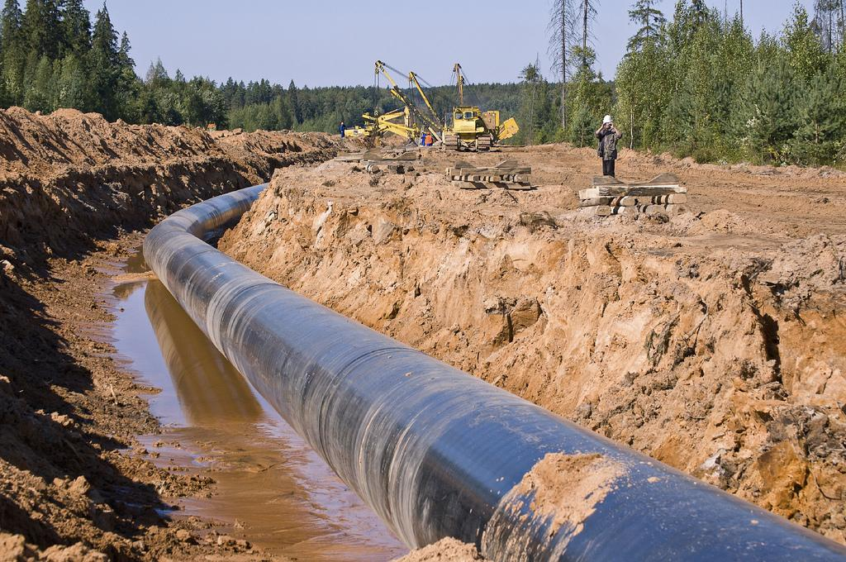
Health Risks Associated with Fracked Gas & Compressor Stations Barbara Gottlieb People’s Tribunal October 2017
Notes:
I’m Barbara Gottlieb, national director for environment and health of Physicians for Social Responsibility, a national organization of physicians and other health professionals working to address the greatest threats to human health and survival. Fossil fuels are one of those threats, and that includes fracked natural gas.
Fracking sites, the pipelines that carry fracked gas, and the compressor stations that pressurize and push that gas through the pipelines, pose risks to health and safety. I’d like to give a very brief introduction to some of the most serious threats to health. I’ll focus on the health threats associated with compressor stations, but I also want to remind us that compressor stations don’t exist in a vacuum. You have compressor stations because you have pipelines; you have pipelines because you have fracked gas. It’s a package deal: they come together. And they share some, though not all, of the same health hazards.

Slide 2
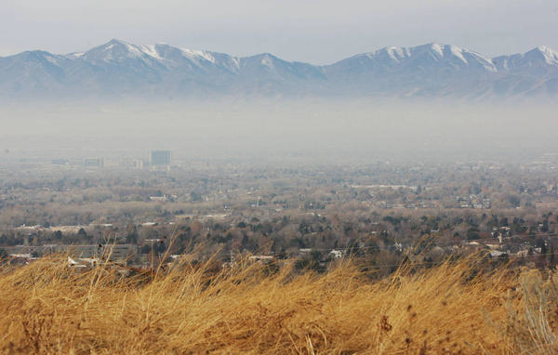
Toxic air pollutants
Benzene: known carcinogen
Toluene: causes miscarriages, birth defects;
Ethylbenzene: may result in blood disorders
Xylene: Long-term exposure may affect the nervous system
Notes:
Pipelines carry natural gas or methane, but that’s not all. They also carry other substances that you don’t want coming into your home, your kitchen, your furnace. Among these are VOCs -- volatile organic compounds -- that are extremely dangerous air toxics. There’s a quartet of VOCs that are associated with natural gas and also with gasoline and other fossil fuels, and commonly occur together. They occur together so much that they’re known by their initials: BTEX. B for Benzene: a known carcinogen – it causes cancer, and there is no safe level of exposure. Toluene can cause birth defects. Ethylbenzene, long-term exposure may result in blood disorders; and xylene, may affect the nervous system.
Compressor stations leak these dangerous gases into the atmosphere, potentially endangering people who live nearby.
VOCs besides being harmful in and of themselves, also combine with other air pollutants to form ground-level ozone, or smog. Smog is a widespread air pollutant that can damage lungs permanently; trigger asthma attacks; and aggravate other chronic lung diseases and pre-existing heart diseases. It’s particularly dangerous to people with asthma, the elderly, and the young. Raise your hand if you know anyone in any of those categories.
TEDX: http://endocrinedisruption.org/chemicals-in-natural-gas-operations/chemicals

Slide 3
Radioactivity
Radioactive elements in Marcellus shales: uranium, thorium, radium, polonium, radon.
Radium and radon levels from Marcellus shale are significantly elevated
Radon travels with methane through the pipelines.
Notes:
Another pollutant associated with compressor stations is radon. Radon is a gas. It occurs naturally in the ground in many parts of Virginia; it’s radioactive. That’s why you test your basement for it. Radon is extremely dangerous: It’s the leading cause of lung cancer among non-smokers and the second-leading cause among smokers. 21,000 lung cancer deaths per year on a nationwide basis are attributed to radon exposure, according to the EPA.
The natural gas which flows through pipelines here in Virginia is likely to carry radon with it. That’s because the Marcellus shale where the gas comes from contains radon, and the radon comes up out of the wells with the methane.
Fortunately radon gas decays or breaks down rapidly. But as it decays, it degenerates into other radioactive substances – radioactive forms of polonium and lead. They last much longer, with half-lives of 22 years and 138 days. These radioactive substances accumulate along the interior of gas pipelines; they can also be found in the sludge that accumulates in tank bottoms, gas/oil separators, and other pieces of natural gas infrastructure. That also includes compressor stations.
Source:
ATSDR- http://www.atsdr.cdc.gov/csem/csem.asp?csem=8&po=5
EPA- https://www.epa.gov/radon

Slide 4
Particulate Matter
Notes:
Another air pollutant associated with compressor stations is particulate matter. Particulates are tiny solid or liquid particles. They are classified not by what chemical substance they are, but by their size. The larger particles are known as PM10, b/c they are 10 millimicrons across They are shown as the blue beads in the picture, where they’re compared to a human hair. Pretty small, huh? Look closer: on the blue dots are red dots. They represent the smaller PM2.5 particle (2.5 millimicrons). They’re tiny – obviously not even visible to the human eye.
These particulates, like the VOCs, escape from compressor stations. They absorb airborne chemicals, then when we inhale them, carrying those chemicals into our bodies. Larger particles, like the PM10, are trapped in your nose and upper respiratory tract. The smaller particles can penetrate deep into the lung and even cross into the blood stream and be carried throughout the body, exposing the whole body to multiple dangerous substances.
Inhaling PM2.5 can cause decreased lung function, can aggravate asthma symptoms, cause nonfatal heart attacks and contribute to high blood pressure. Long-term, repeated exposures increases the risk of cardiovascular disease and death.
Source: Lee B-J, Kim B, Lee K. Air Pollution Exposure and Cardiovascular Disease. Toxicological Research. 2014;30(2):71-75. doi:10.5487/TR.2014.30.2.071. http://www.ncbi.nlm.nih.gov/pmc/articles/PMC4112067/

Slide 5
Most Vulnerable: Children, pregnant women
Notes:
Children and pregnant women are especially sensitive to particulates.
Children are especially vulnerable because their lungs are developing and growing, they breathe at a faster rate than adults, and many children spend more time playing outdoors. Asthmatic children are particularly vulnerable, and as you probably know, childhood asthma is at epidemic rates. This should be a major cause of concern if you live near a compressor station.
High levels of particulate pollution also cause health effects in pregnant women, where it is associated with low birth weight and preterm births. Premature birth is the #1 cause of infant death in the U.S. Let me say that again.
Source: Southwest Environmental Health Project-summary of compressor stations: http://www.environmentalhealthproject.org/researchers/resources

Slide 6
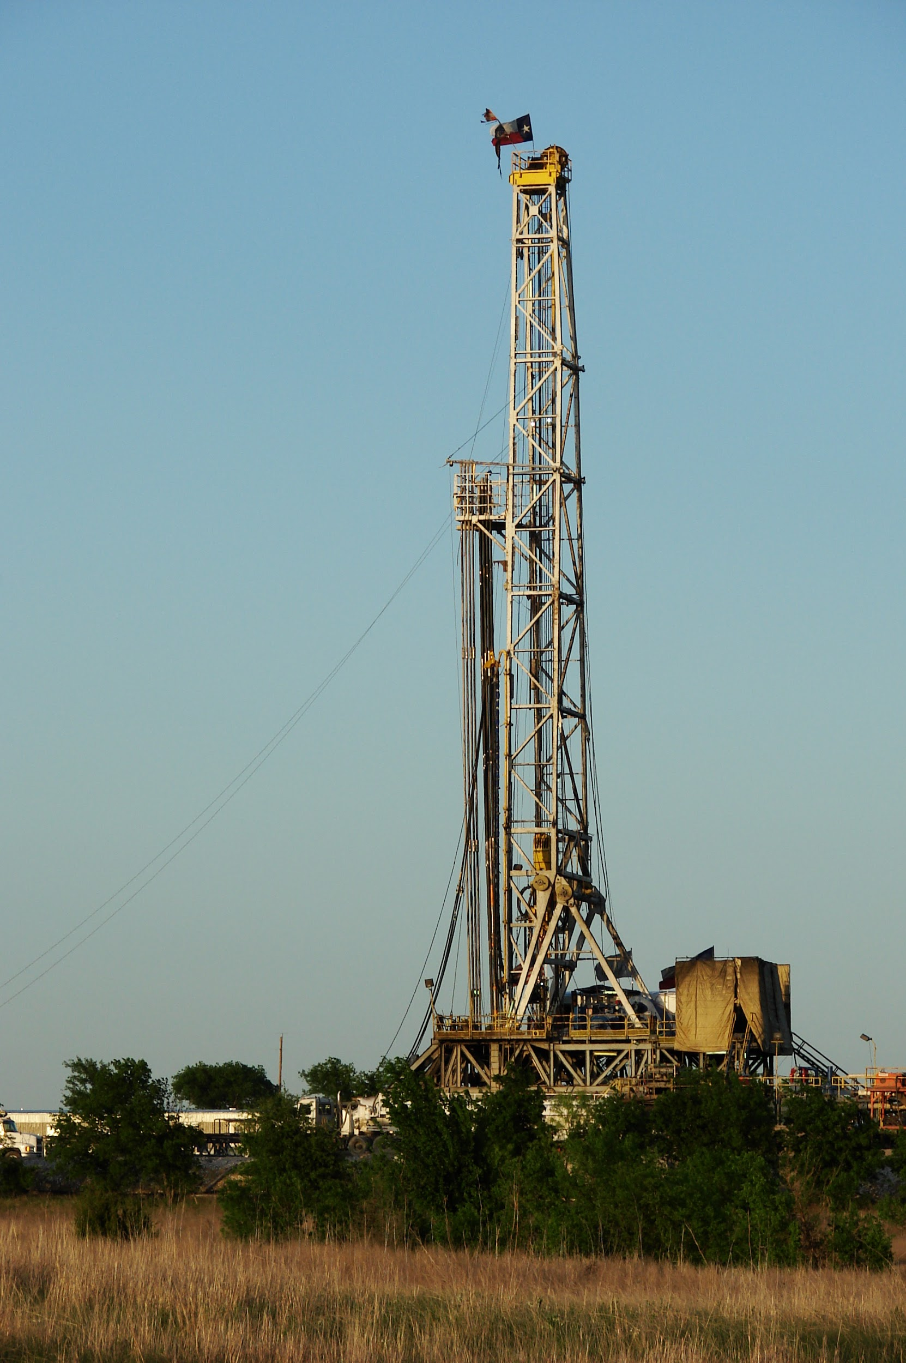
Fracking: Heavy industry in rural areas
Notes:
Although we’re focusing on compressor stations, let’s remind ourselves that you don’t get compressor stations without pipelines, and you don’t get pipelines without fracking. No fracking, no pipelines; no pipelines, no fracking. This is what fracking looks like. It is heavy industrial activity. It requires a lot of land clearing, heavy truck traffic, diesel engines, noise and pollution. This is what’s happening in your neighboring state of West Virginia, as well as more than 30 other states across the country.
Top picture: A hydraulic fracturing operation at a Marcellus Shale well. Photo from Wikipedia and is licensed to reuse
Bottom picture: Shale gas rig near Alvarado, Texas. Photo from is licensed to reuse

Slide 7
Methane: potent climate change gas
Notes:
Finally, let’s talk about the natural gas itself. Natural gas itself is primarily methane. Methane is a “greenhouse gas,” one of those gases (like carbon dioxide) that, when they occur in the atmosphere, they trap the sun’s heat. That in just a few words is what causes climate change. It’s that straightforward. And climate change, as I’ll tell you in a moment, makes us sick.
Methane, or natural gas, is a highly potent greenhouse gas: 86 times more powerful at trapping heat in the atmosphere than CO2 , over its first 20 years in the atmosphere.
This makes it hard to keep world temperatures livable.
And here’s the problem: Methane leaks throughout fracked-gas operations: at the fracking wells, from compressor stations and pipelines, and even from the pipes that distribute it to our homes for heating and cooking. All of these leaks contribute to climate change––at exactly the time we need to slash greenhouse gas emissions if we are to avoid climate catastrophe.
IPCC for 86X more potent: http://www.ipcc.ch/report/ar5/index.shtml

Slide 8
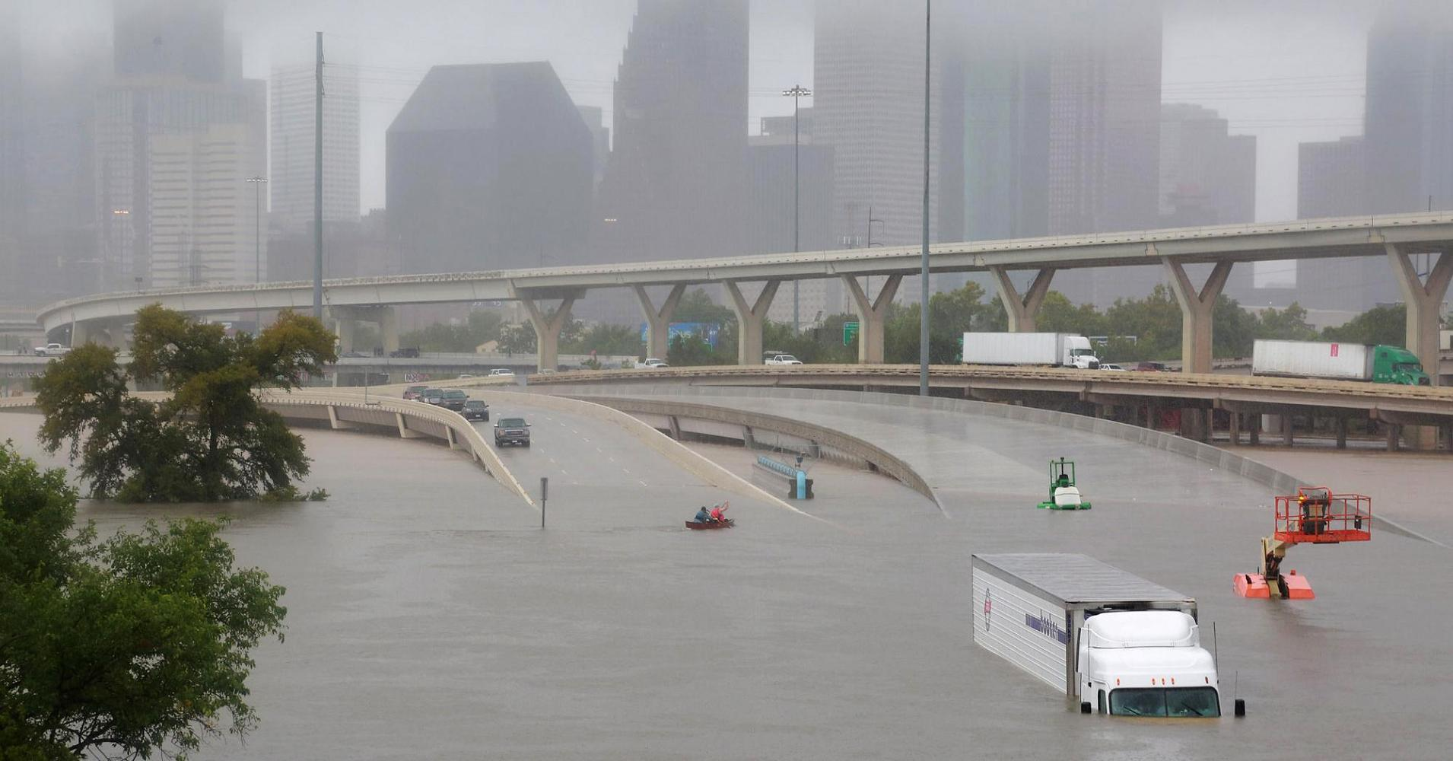
Climate Change 2017 in the U.S.A.
Houston, Texas
Notes:
On behalf of Physicians for Social Responsibility, let me remind us all how climate change is affecting Americans, here and now. Here’s what climate change looked like in Houston, Texas.

Slide 9
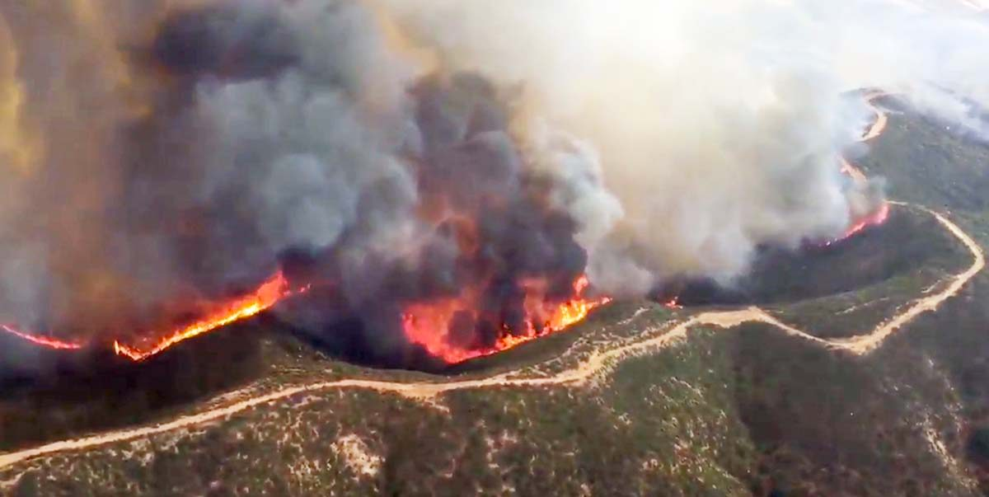
Climate Change 2017 in the U.S.A., continued
California
Notes:
And in California.

Slide 10
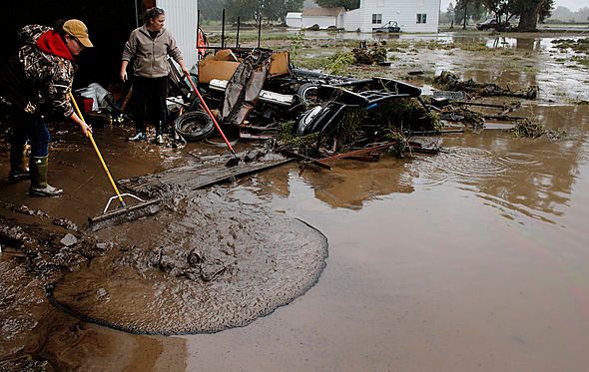
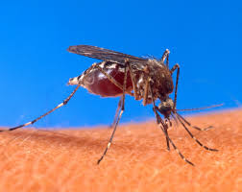
Intense precipitation: Floods, sewage contamination, insect-borne diseases
Notes:
Climate change contributes to more frequent, more intense storms, which means more floods, more sewage contamination, and the spread of disease-carriers like mosquitoes.

Slide 11
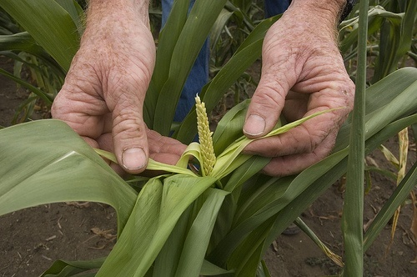
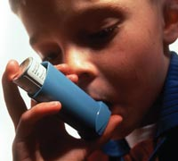
Extreme heat: Drought, more air pollution…
Notes:
In some parts of the U.S., climate change is contributing to droughts, severely impacting crop production... increasing particulate matter in the air… and increasing ozone air pollution, which forms in the presence of sunlight and heat…

Slide 12
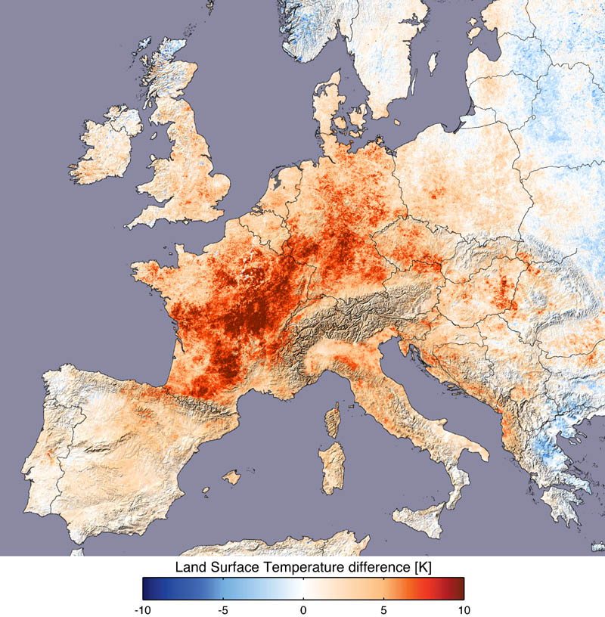
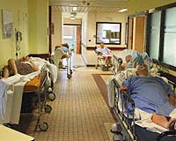
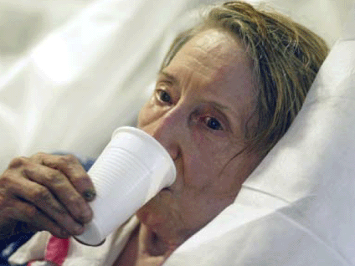
…and deadly heat waves
Notes:
And climate change causes heat waves, which are real killers. In a heat wave that hit western Europe in 2003, over 70,000 people died.

Slide 13
Doctors recognize the threat
American Medical Association Resolution #519 (2015):
“our American Medical Association recognizes the potential impact on human health associated with natural gas infrastructure”
“our American Medical Association supports legislation that would require a Comprehensive Health Impact Assessment regarding the health risks that may be associated with natural gas pipelines.”
Notes:
The U.S. medical community is growing concerned about the health risks associated with natural gas. The American Medical Association – not a radical group - passed a resolution saying that it “recognizes the potential impact on human health associated with natural gas infrastructure” and calling for Comprehensive Health Impact Assessments regarding the health risks that may be associated with natural gas pipelines.
AMA: link to citing of resolution: https://tompkinscountyny.iqm2.com/Citizens/Detail_LegiFile.aspx?MeetingID=2313&ID=5724

Slide 14
PSR’s Conclusions
Fracked gas: toxic air, water and soil contamination.
Pipelines and compressor stations transmit serious health risks to new communities.
PSR recommends:
precautionary approach;
ban fracking;
reject pipelines;
promote renewable energy and energy efficiency: cleaner, healthier
Notes:
PSR wants you to know: fracked gas exposes people to toxics through air, water and soil contamination. Pipelines and compressor stations transport dangerous air pollutants and radioactive materials to communities located far from drilling sites – like Buckingham County, VA. And of course, all of us are endangered by climate change.
Therefore, PSR recommends:
Follow a precautionary approach. If you can’t prove that it’s safe, don’t find out by testing it on us. //
Ban fracking. Don’t build more pipelines.
Work for clean, healthier forms of energy like solar energy and wind. They are the path to a livable future. Thank you.

