Slide 1
Bob & Mary Moore Picture Testimony
VA People’s Tribunal

Slide 2
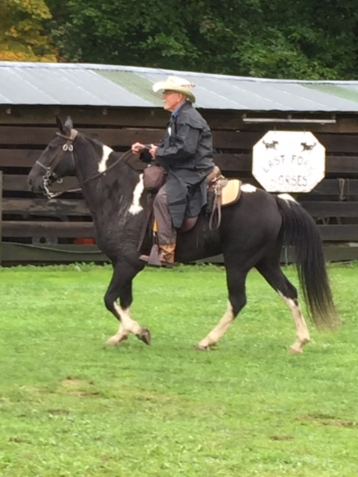
Dad with Sue

Slide 3
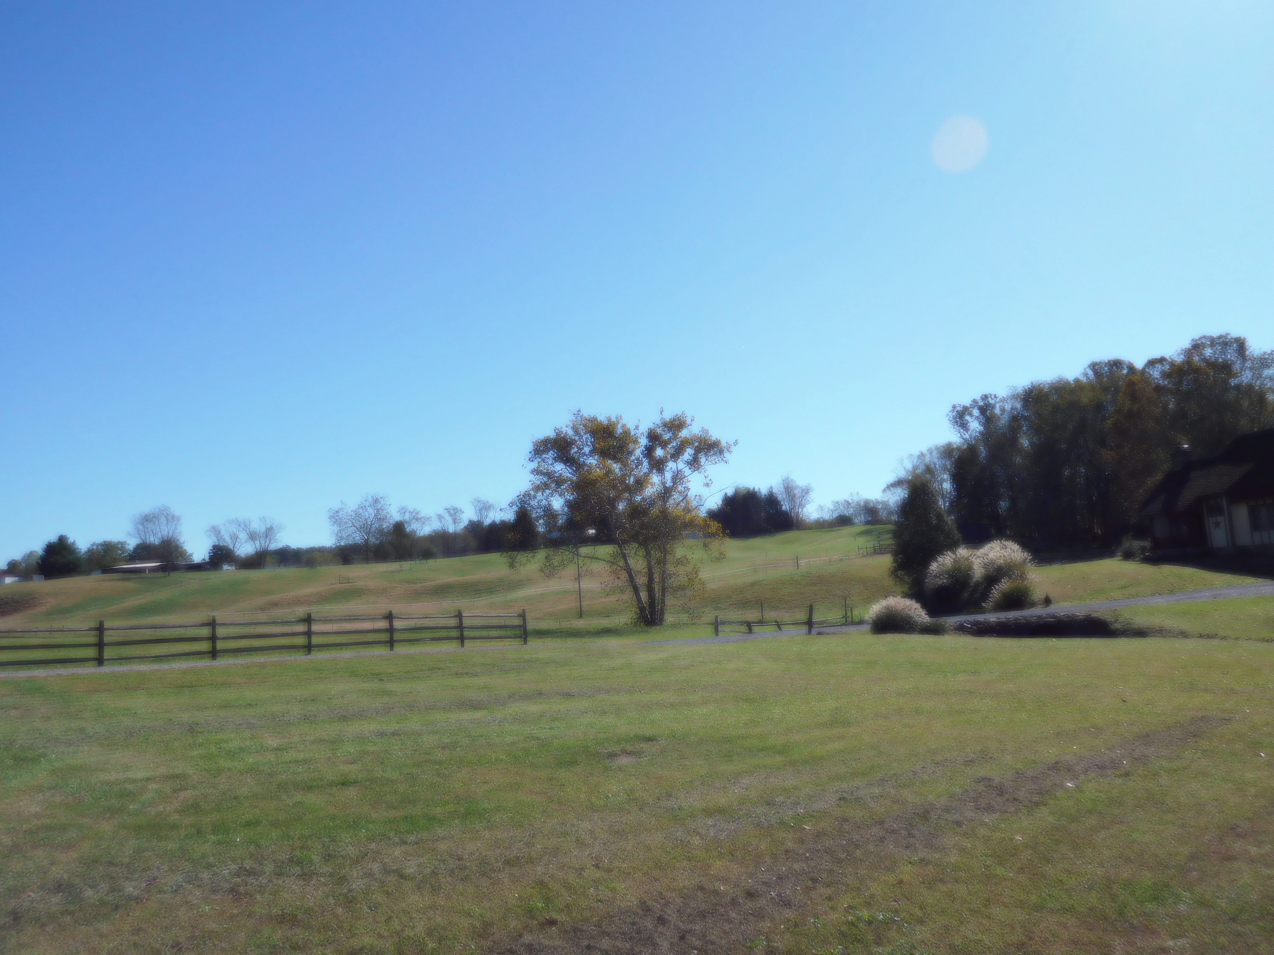
Farm

Slide 4
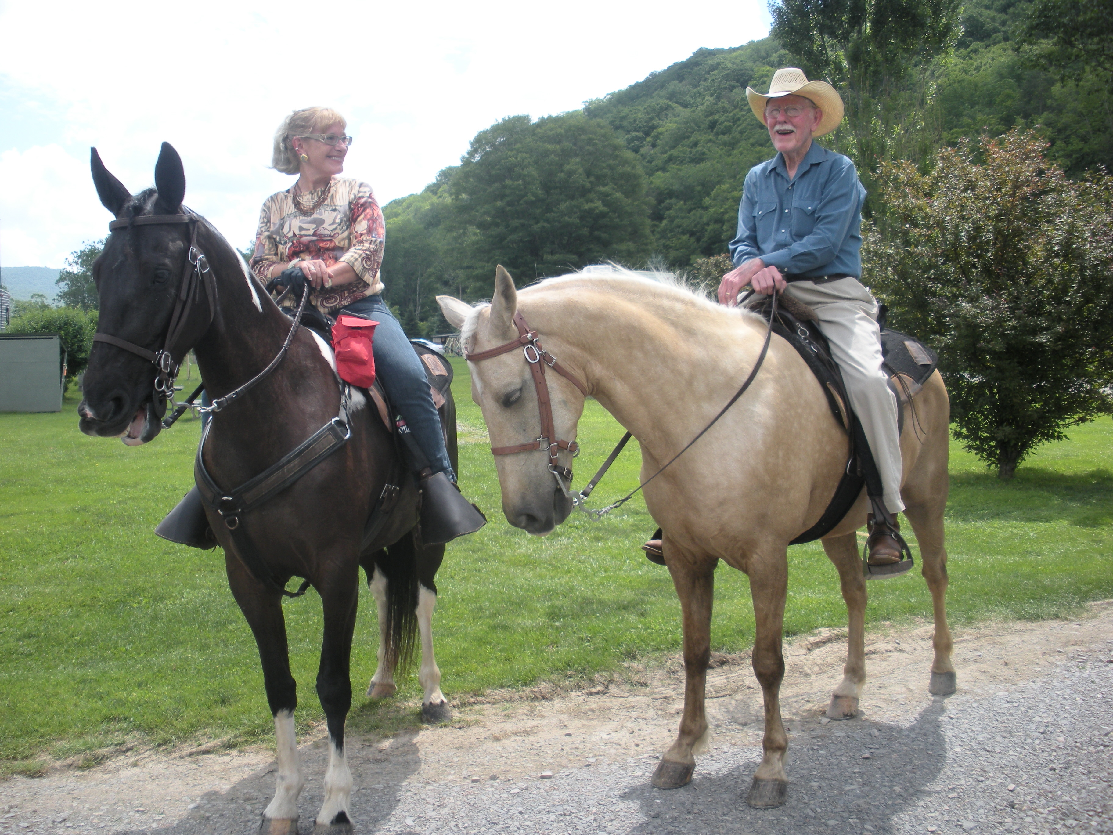
Riding with Dad

