Slide 1
Union Hill Compressor Station Structure
Peter Paire

Slide 2
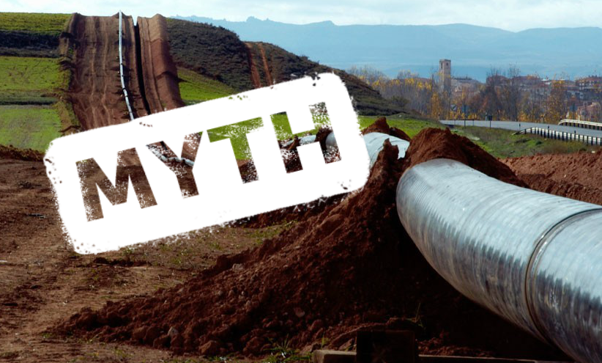
NO
COMMON GOOD!!!

