Slide 1
Union Hill Compressor Station Structure
Peter Paire

Slide 2

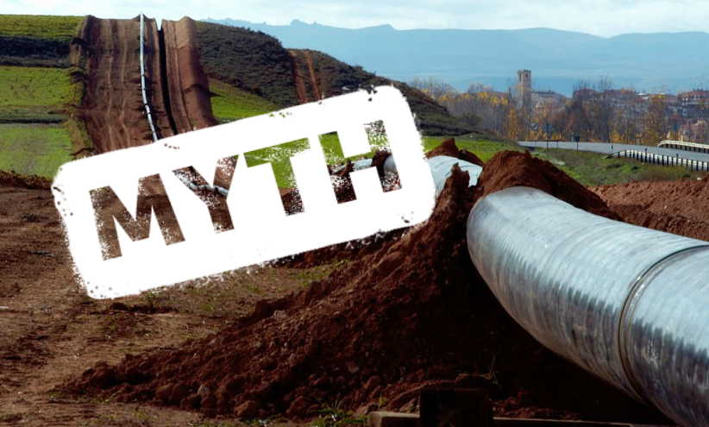
NO
COMMON GOOD!!!

Slide 3
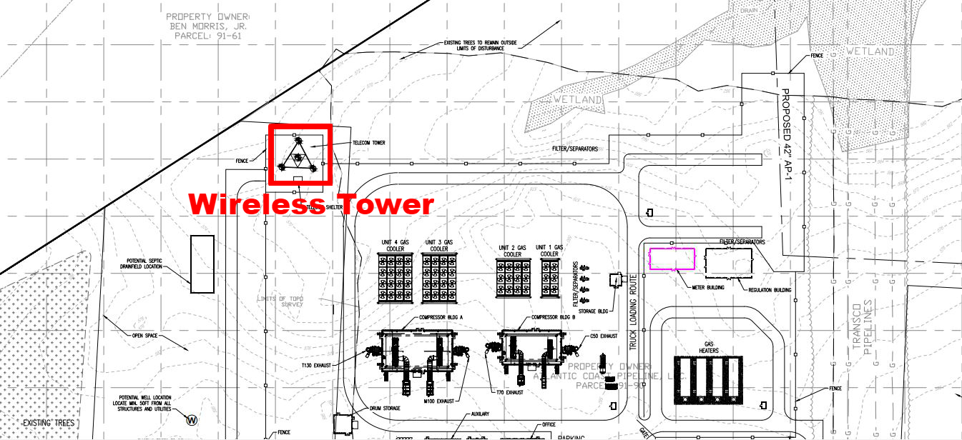

Slide 4
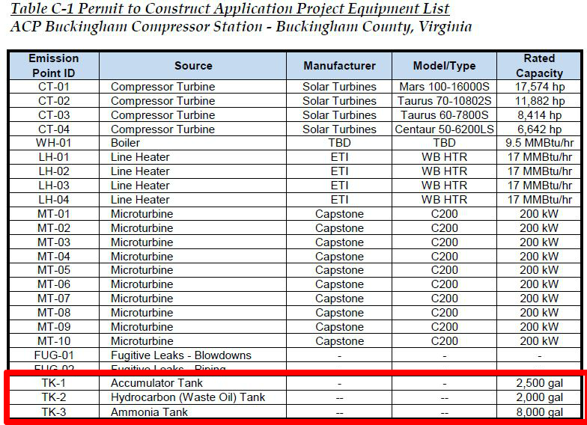

Slide 5
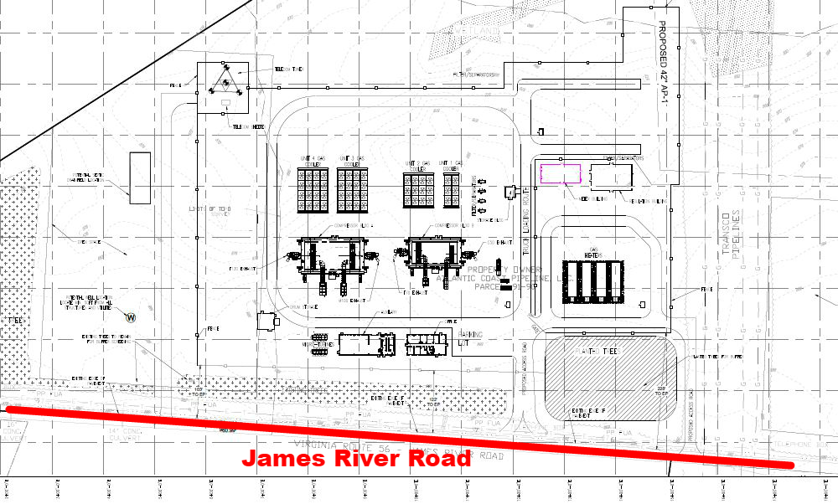

Slide 6
