Slide 1
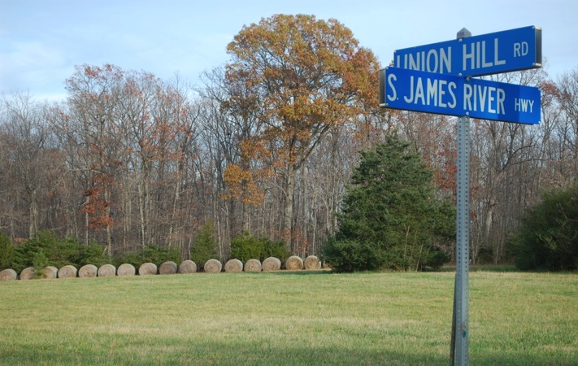
Union Hill / Woods Corner, Buckingham, VA: CS 2
Most Endangered Virginia Historic Place
Preservation Virginia listing, May 3, 2016
Lakshmi Fjord, Friends of Buckingham

Slide 3
99 Densely clustered households on all sides of ACP CS site: 85% African American; 33% known to be descendants of Freedmen; For 66% of households = 158 people live within 500 ft – 1 mile of CS on former Variety Shade Plantation
660 Shelton Store Rd.
ACP route
Rt.660
Rt. 56
663 Union Hill Rd.
Transco Pipeline
663 Woods Rd.
ACP route

Slide 5
Gathering to Plan Door-to-Door Household Survey: VSEC & CVLLE Rising at Union Grove Missionary Baptist Church

Slide 8
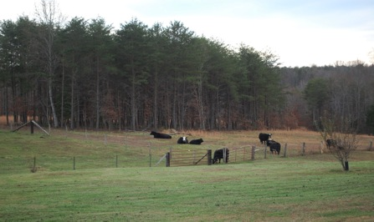
660: Shelton
Store
663/660
Laury Farm

Slide 9
Union Hill Baptist Church est. 1868 in a brush arbor. Rebuilt 1887, original burned

Slide 10
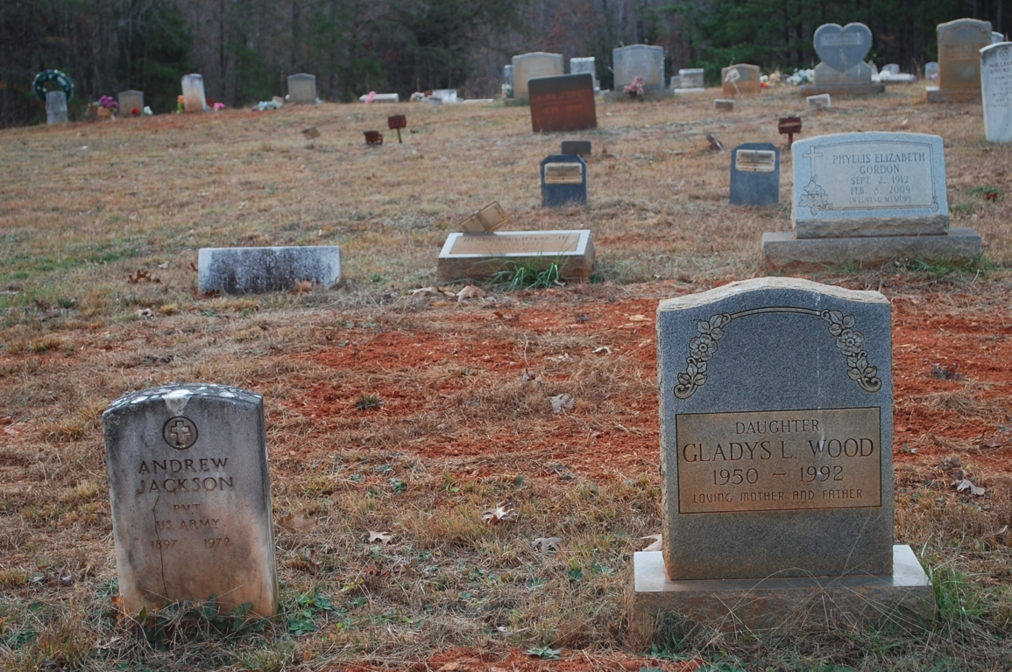

Slide 11
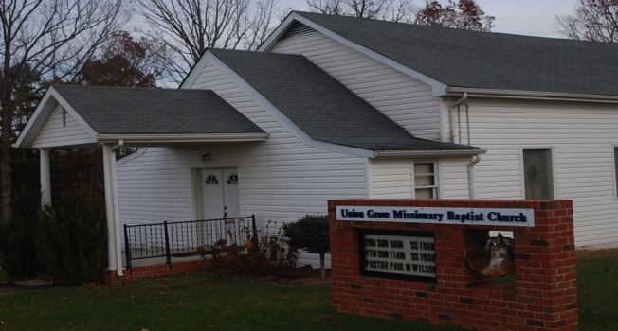
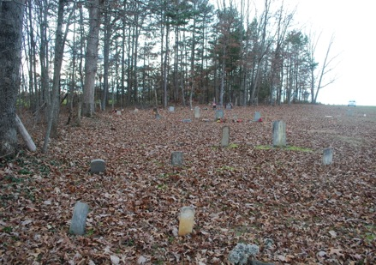
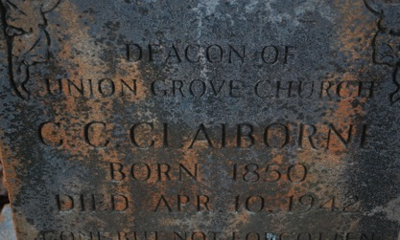
Union Grove
Baptist Church; 1 of 2 Black cemeteries

Slide 13
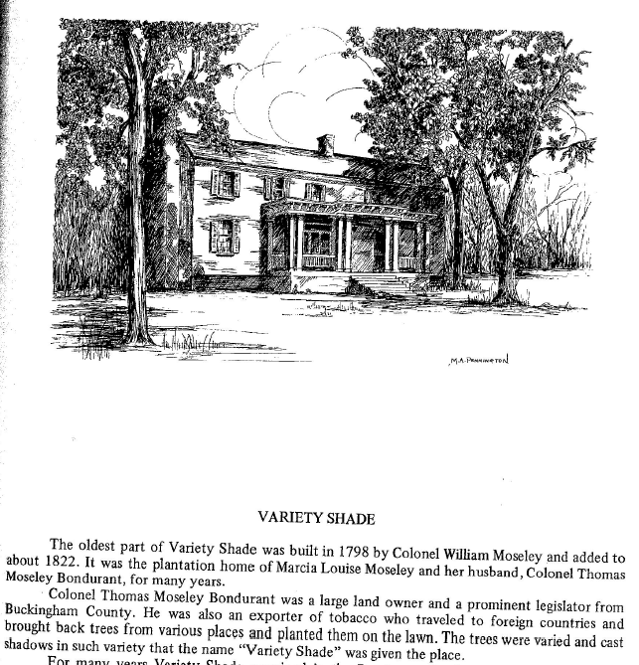

Slide 14
Detail: Henshaw slave cemetery map; 30-50 more sites to be added

Slide 15
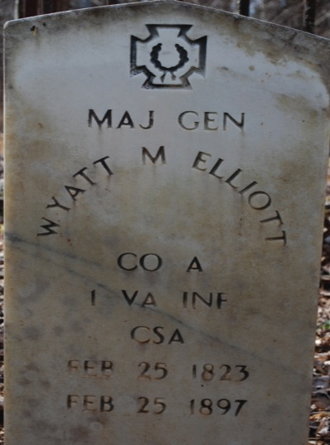
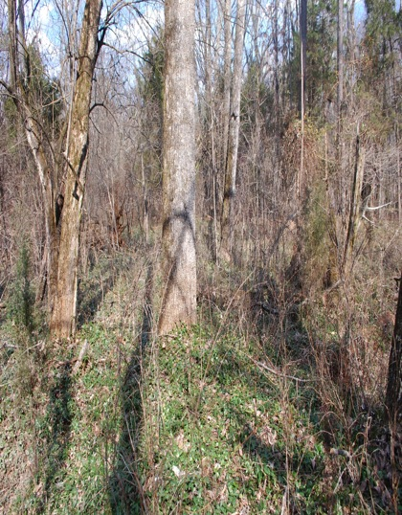
Variety Shade Plantation, Bondurant Cemetery, Whites (left)
Slaves (right); 100s of unmarked slave burials

Slide 16
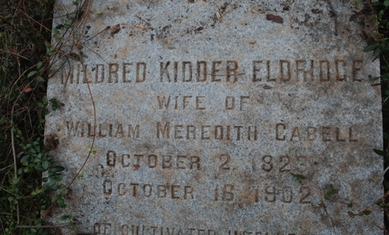
Rt. 663 W: Wilderness

