Slide 1
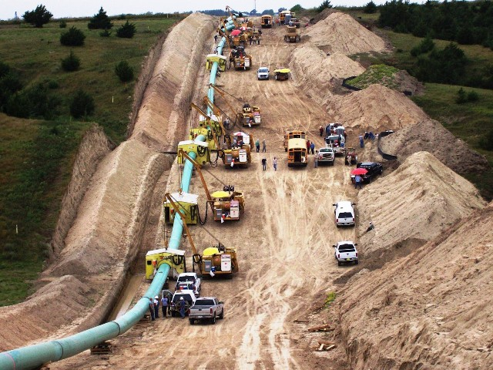
Do we need more pipelines?

Slide 2
What we have been told

Slide 3
What we have been told
Essential

Slide 4

What we have been told
Essential

Slide 5
What we have been told
Essential
Save money

Slide 6

What we have been told
Essential
Save money

Slide 7
What we have been told
Essential
Save money
Create Jobs

Slide 8

What we have been told
Essential
Save money
Create Jobs

Slide 17
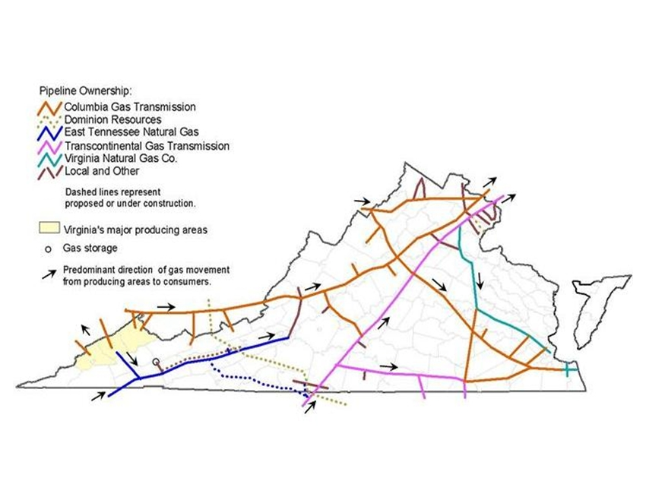
Existing Pipelines

Slide 18
Existing Pipelines

Slide 19
Existing Pipelines

Slide 20
Existing Pipelines

Slide 21
Existing Pipelines

Slide 22
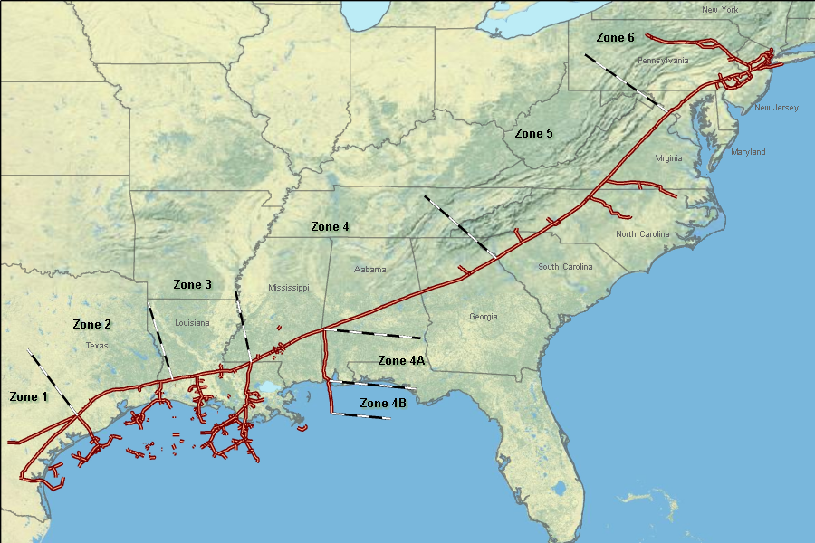
Existing Pipelines

Slide 23
Existing Pipelines

Slide 24
Existing Pipelines

Slide 25
Spoken For?

Slide 26
Spoken For?

Slide 27
MVP – No Customers

Slide 28
MVP – No Customers

Slide 29
MVP – No Customers

Slide 30
MVP – No Customers

Slide 31
MVP – No Customers

Slide 32
Save Us Money?

Slide 33

Save Us Money?
ACP saves $377
million / year

Slide 34
Forgot to Include Pipeline

Slide 35

Forgot to Include Pipeline

Slide 36
Forgot to Include Pipeline
DOH!

Slide 37
Save Us Money?
ACP costs us
billions more !

Slide 38
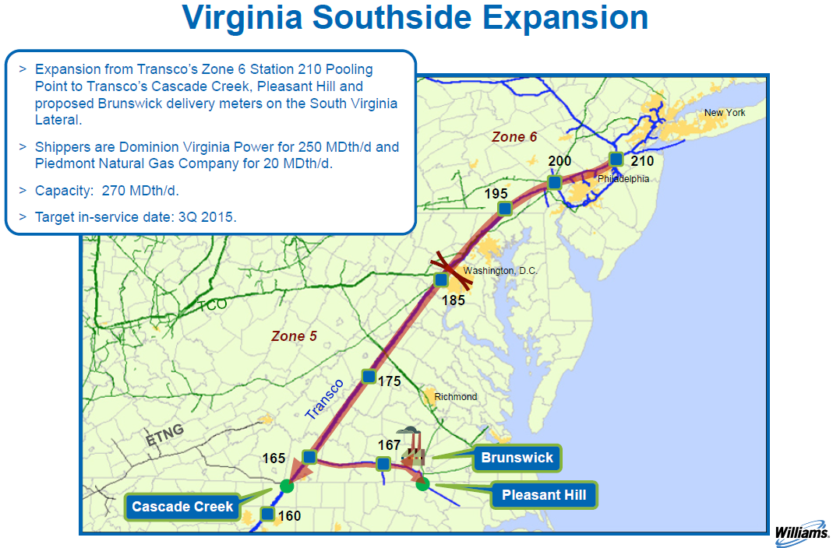
Existing vs. ACP

Slide 39
Existing vs. ACP
gas+ plus
transportation

Slide 40
Existing vs. ACP
ACP costs
28% more !

Slide 41

Dominion Ratepayers
Net $2 billion more !

Slide 42

Who is speaking for us?

Slide 43



Higher costs – fewer jobs

Slide 44
Higher costs – fewer jobs

Slide 45
Higher costs – fewer jobs

Slide 46

FERC

Slide 47

Ignores need & higher costs

Slide 48

Considers only contracts

Slide 49
Unnecessary- Cost More

Slide 50
Unnecessary- Cost More
Public Benefit?

Slide 51
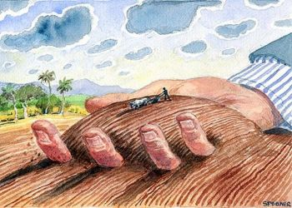
Justify Seizing Land?

Slide 52
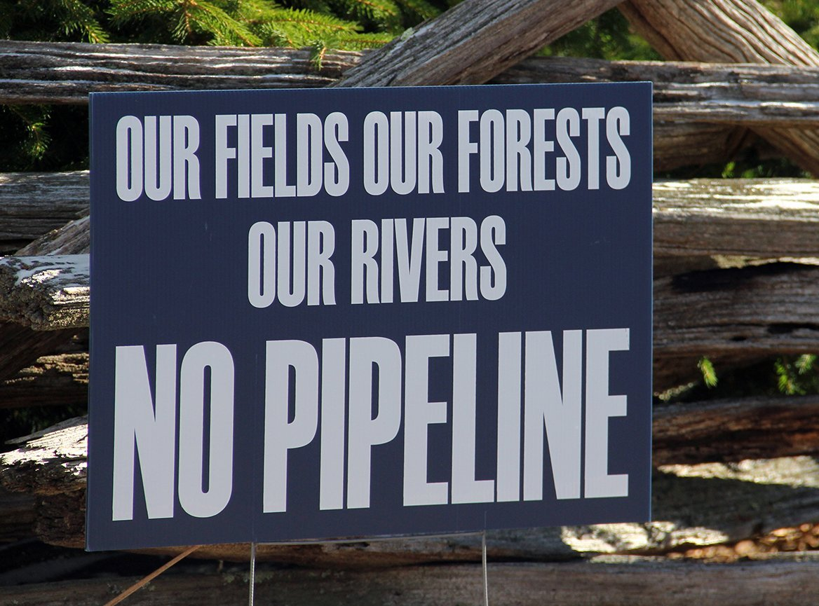
Unwilling to Give it

Slide 53
Disproportionate Harm

Slide 54
Disproportionate Harm
Higher energy costs- Seizure of land

Slide 55
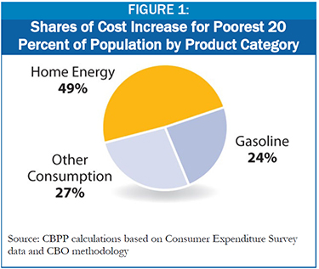
Disproportionate Harm
Higher energy costs- Seizure of land

Slide 56

We have no voice?

Slide 57

Create power from our collective voice

Slide 58


Slide 59

Say “Yes” to a future free from new pipelines

Slide 60


