Slide 1
Pipeline Corridor Aerial photo

Slide 2
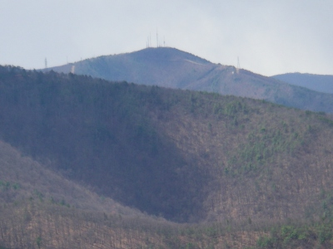
Bent Mountain

Slide 3
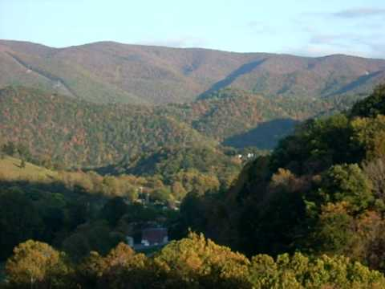
Poor Mountain

Slide 4
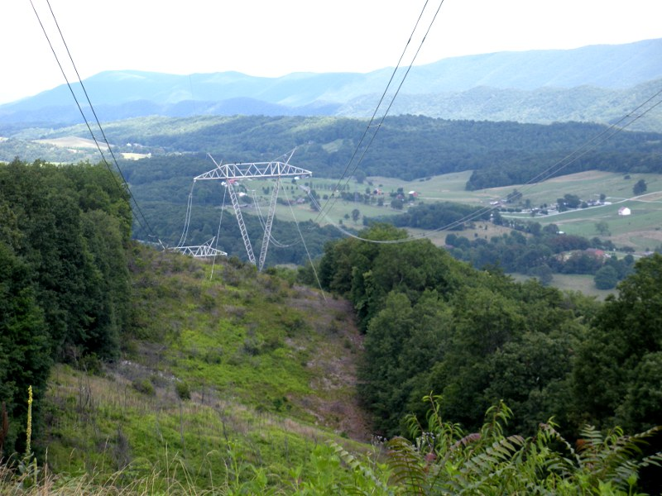

Slide 5
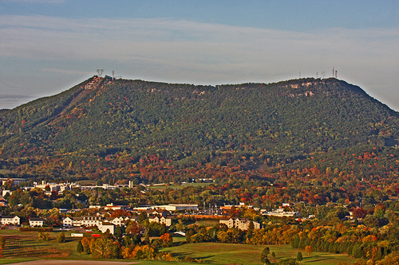
Tinker Mountain

Slide 6
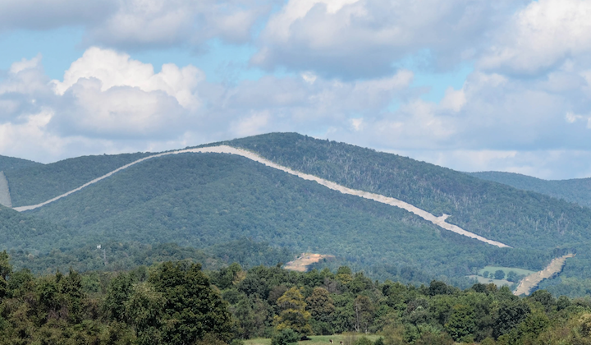
MVP Crossing Peters Mountain and AT

Slide 7
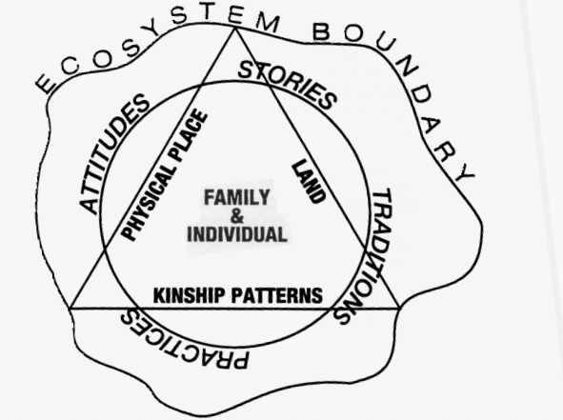
FIGURE 2: CULTURAL ATTACHMENT MODEL

